Slide 1
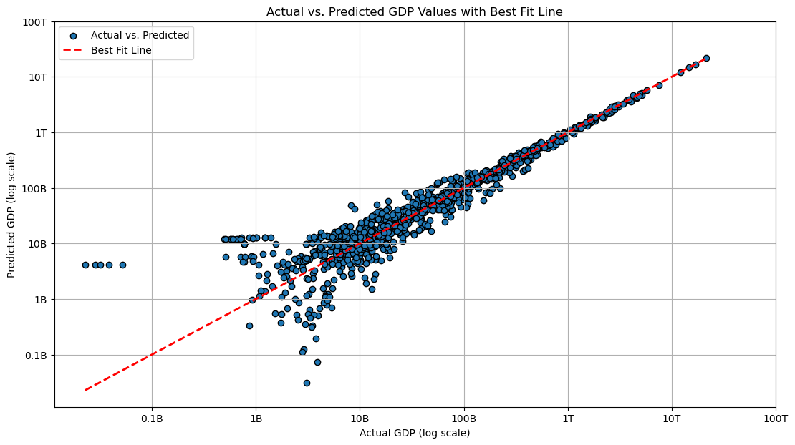
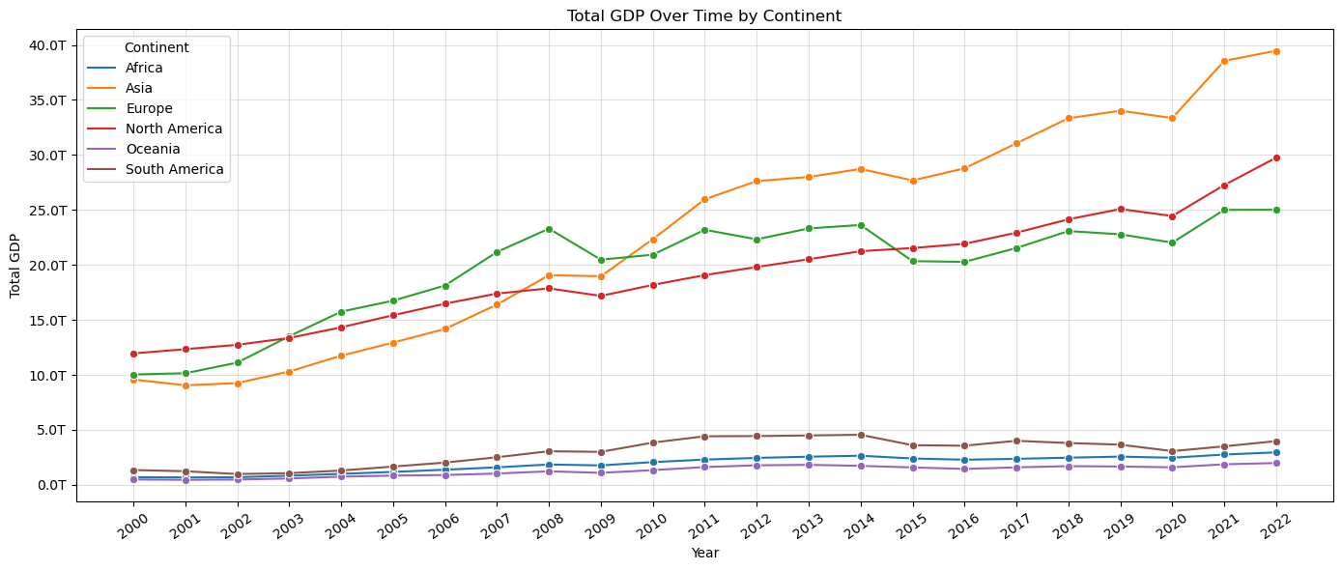
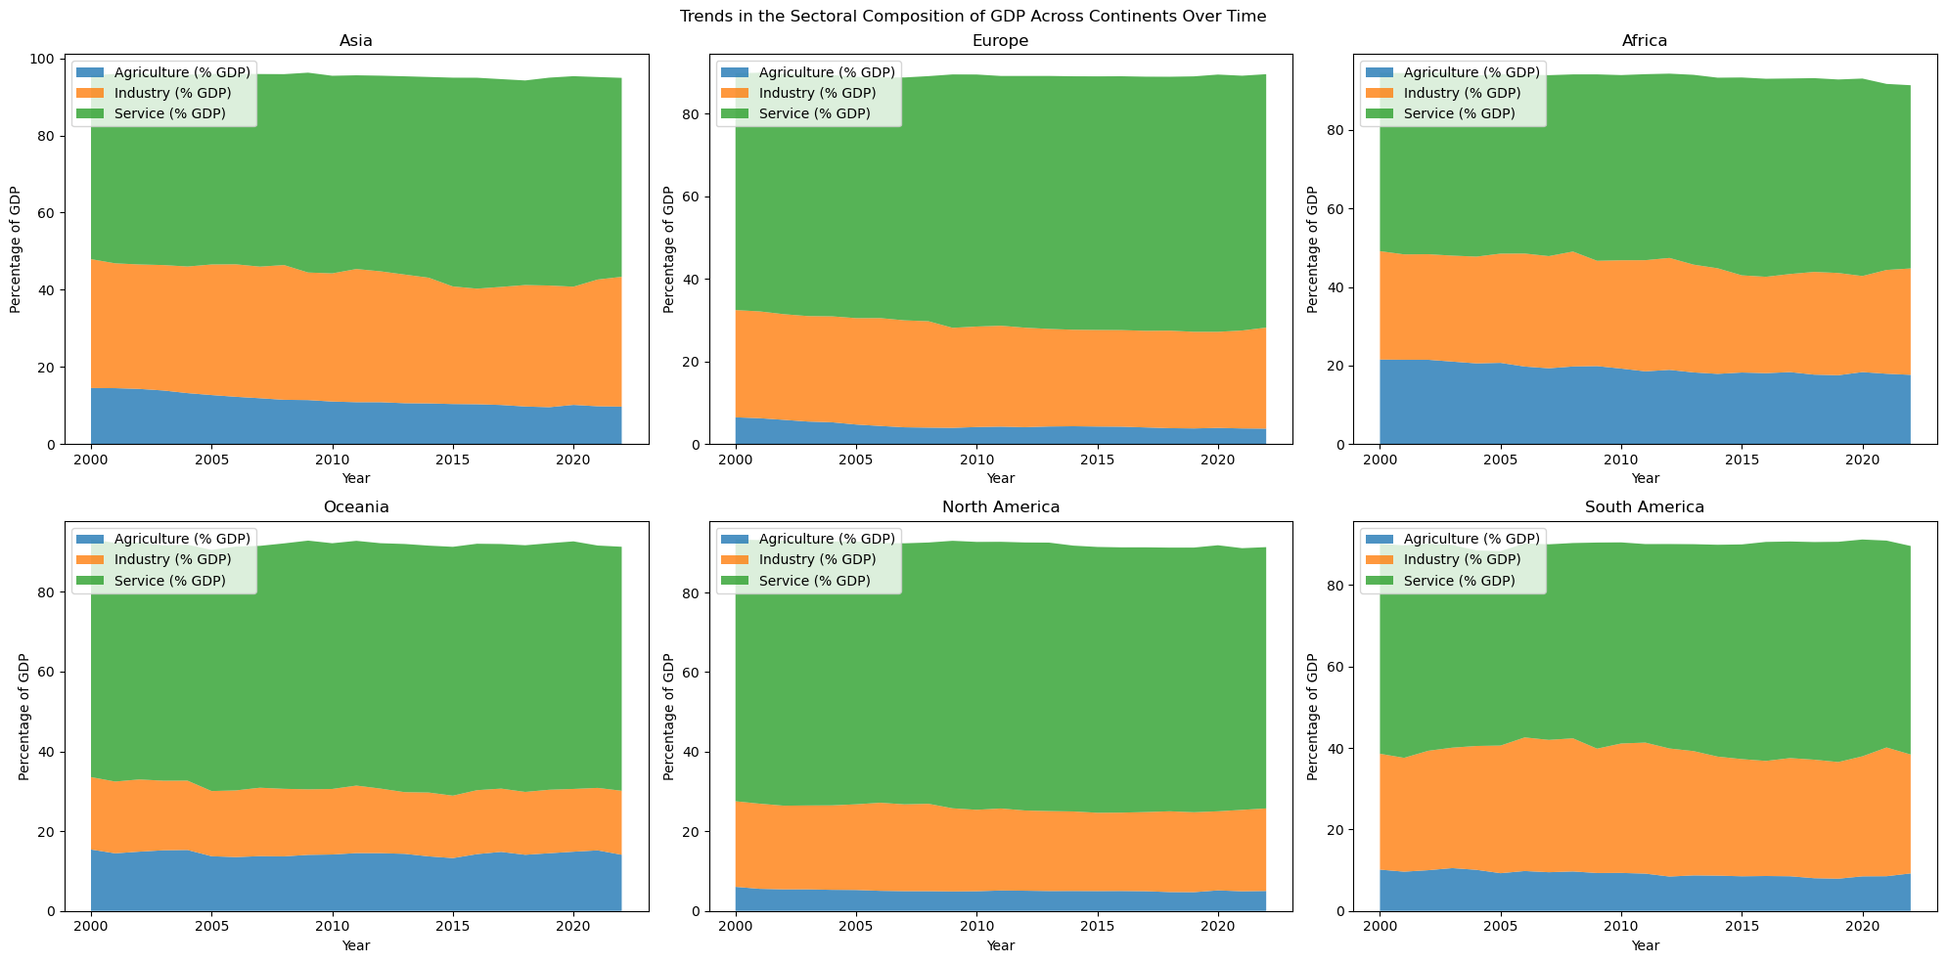
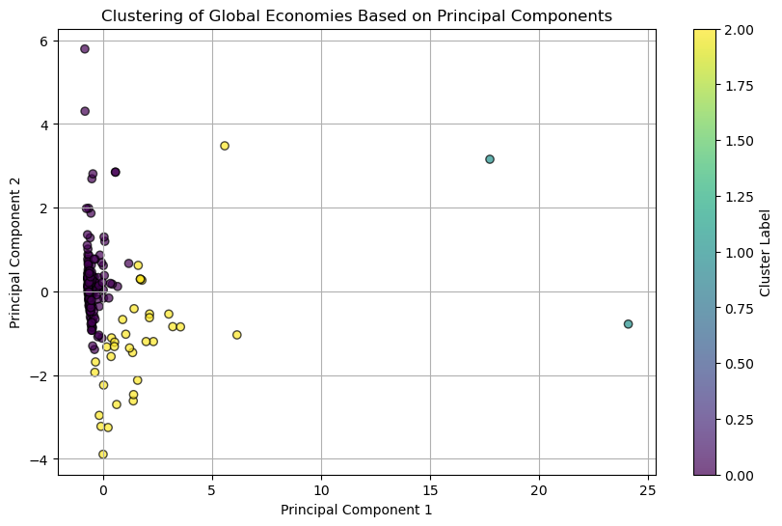
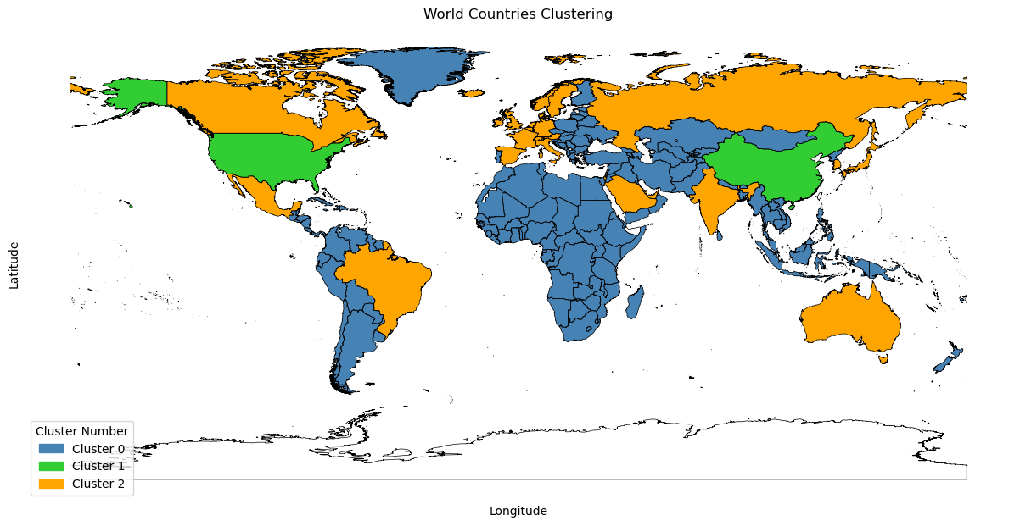
Analyzing Economic Growth: Factors and Predictive Trends
Name: Sherali Ozodov
College/School: School of Information
University of Arizona
Introduction
This project explores the complex factors behind economic growth, going beyond traditional GDP per capita assessments. Using machine learning techniques, we analyze a broad set of economic indicators such as health and education spending, and trade dynamics. Our aim is to predict economic trends and classify countries by development stages, providing a deeper understanding of economic growth drivers.
Exploratory Data Analysis
Figure 1: Total GDP Growth Over Time by Continent
Figure 2: Sectoral GDP Composition by Continent Over Time
Cluster 0: Emerging Economies
Characteristics: Countries in this cluster exhibit emerging market conditions with varying stages of economic development.
Key Indicators:
GDP: Moderate, with a mean of $92.99 billion.
Inflation Rate: Relatively high, averaging 11.96%.
Trade Activities: Active participation in trade, with significant export and import volumes.
Implications: These economies show potential for growth but may face challenges related to inflation and trade imbalances.
Cluster 1: Dominant Economies
Characteristics: Comprising major global economic powers with substantial influence.
Key Indicators:
GDP: Exceptionally high, averaging $21.71 trillion.
Stability: Low inflation rates, averaging 4.99%.
Investments: Significant allocations to health and education sectors.
Implications: These economies drive global economic trends and boast high standards of living.
Cluster 2: Developed Economies
Characteristics: Well-established economies with advanced industrial and technological bases.
Key Indicators:
GDP: Moderate to high, averaging $1.25 trillion.
Inflation Rate: Moderate, with some variability.
Investments: Strong focus on education and innovation.
Implications: These economies prioritize education and innovation, contributing to sustained growth and competitiveness.
Methods
Our analytical approach incorporates several sophisticated machine learning techniques:
Linear Regression: We used this to establish baseline relationships between GDP and various economic indicators, providing a straightforward understanding of the direct impacts.
Polynomial Regression: This method allowed us to capture more complex, non-linear interactions between variables, offering deeper insights into the subtleties of economic dynamics.
Ridge Regression: To address potential overfitting and improve the generalizability of our models, we applied Ridge Regression, which adjusts the coefficients to prevent them from growing too large.
K-Means Clustering: We implemented this technique to identify and group countries with similar economic profiles, facilitating comparative analyses and targeted insights.
The dataset, sourced from the World Bank, spans from 2000 to 2022 and includes comprehensive economic data from 215 countries. This rich dataset enabled a robust exploration of global economic patterns.
Figure 3: Scatter plot showing the actual versus predicted GDP values
Cluster Analysis of Global Economies
Feature Selection: We selected relevant economic indicators including GDP, inflation rate, health expenditure, education expenditure, export, import, population, and GDP per capita.
Dimensionality Reduction: Principal Component Analysis (PCA) was applied to reduce the dimensionality of the feature space while retaining important information.
Clustering Algorithm: K-Means clustering was employed to group countries into clusters based on their principal components.
Figure 4: Clustering of Global Economies Based on Principal Components
The dataset has been partitioned into clusters using the K-Means algorithm. Here is the distribution of observations in each cluster:
Cluster 0: 186 observations
Cluster 1: 2 observations
Cluster 2: 34 observations
Figure 4: Clustering of World Countries
Results
Multivariate Polynomial Regression Analysis:
Model Complexity: We incorporated polynomial features of degree 2, enhancing the model's ability to capture non-linear relationships in the data.
Data Preparation: Standardization and imputation were applied to ensure consistency.
Model Accuracy
RMSE (Root Mean Square Error): The model achieved an RMSE of 56,770,177,062.45, which represents the average deviation of the predicted GDP from the actual values.
R² (Coefficient of Determination): The model's R² value is 0.99742, indicating that approximately 99.74% of the variability in GDP can be explained by the model.
Interpretation of Results
Relative Performance: The RMSE corresponds to 18.19% of the mean GDP, which, considering the large scale and variability of GDP (standard deviation of 1,405,806,885,993.53), suggests the model has a reasonable level of predictive accuracy.
Overall Assessment: Given the complexity of economic indicators and the inherent unpredictability of GDP, the model demonstrates robust performance.
Key Economic Indicators Analyzed
GDP (Gross Domestic Product): Measures the total economic output of a country, reflecting overall economic health.
GDP Per Capita: Represents the average economic output per person, providing a gauge of individual income and living standards.
Health Expenditure: Represents the total dollar amount spent on health, providing insight into a country's investment in healthcare relative to its economic size.
Education Expenditure: The total dollar amount invested in education, highlighting the financial commitment to educational development within a country.
Inflation Rate (%): The annual percentage change in the cost of living, crucial for understanding economic stability.
Net Trade: Calculated as the dollar difference between exports and imports, this feature indicates whether a country has a trade surplus or deficit, affecting its economic balance.
Population: Total population figures, important for scaling other indicators.
Sector Contributions (Agriculture, Industry, Services): Shows the dollar value contributed by each sector to the GDP, illustrating the economic distribution and sectoral strengths of a country.
Conclusion
This study leveraged a suite of machine learning techniques to unpack the intricacies of economic growth. The analysis revealed that investments in research and development, healthcare, and education are pivotal in boosting a nation's economic output. The predictive accuracy of the models, particularly the high R² value, underscores the potency of these indicators as reliable predictors of GDP.
Through cluster analysis, this study categorizes the world's economies into distinct groups, providing a nuanced perspective that reveals the unique economic conditions and needs of various regions. This segmentation provides clear guidance for customized policy measures, addressing the distinct economic characteristics of each cluster.
Future investigations could expand on this framework by integrating emerging economic factors such as digital transformation and environmental sustainability, which are poised to play pivotal roles in shaping future economic landscapes.

